Slide 1
MANE 4240 & CIVL 4240
Introduction to Finite Elements
Prof. Suvranu De
Higher order elements

Slide 2
Reading assignment:
Lecture notes
Summary:
Properties of shape functions
Higher order elements in 1D
Higher order triangular elements (using area coordinates)
Higher order rectangular elements
Lagrange family
Serendipity family

Slide 3
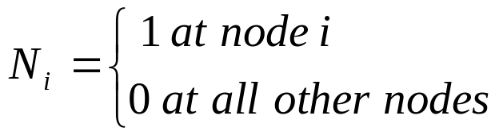

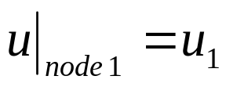
Recall that the finite element shape functions need to satisfy the following properties
1. Kronecker delta property
Inside an element
At node 1, N₁=1, N₂=N₃=…=0, hence
Facilitates the imposition of boundary conditions

Slide 4

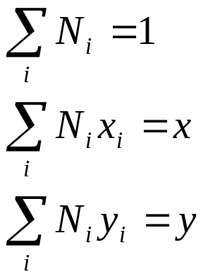
2. Polynomial completeness
Then

Slide 5
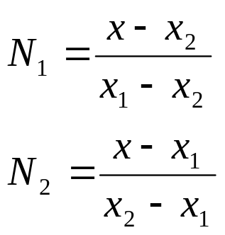
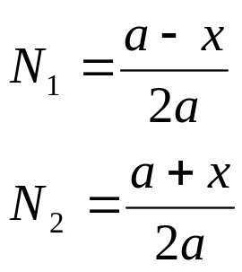
Higher order elements in 1D
2-noded (linear) element:
x₁
x₂
x
1
2
In “local” coordinate system (shifted to center of element)
x
1
2
a
a

Slide 6
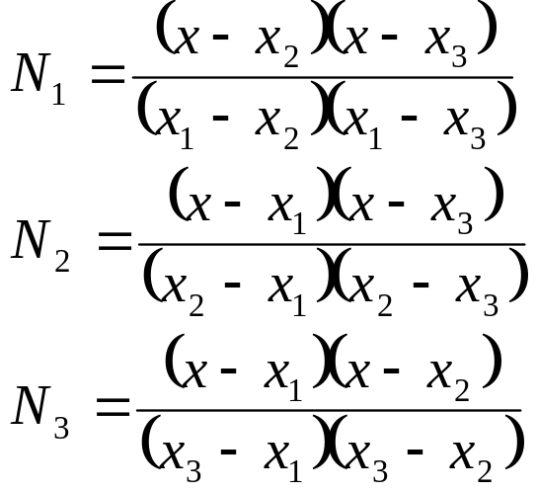

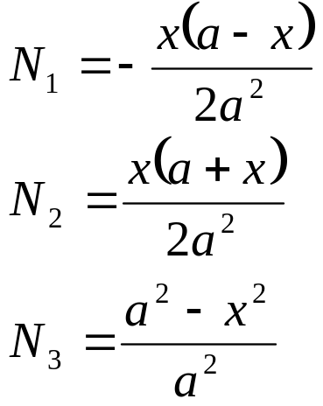
3-noded (quadratic) element:
x₁
x₃
x₂
x
1
3
2
In “local” coordinate system (shifted to center of element)
x
1
3
2
a
a

Slide 7
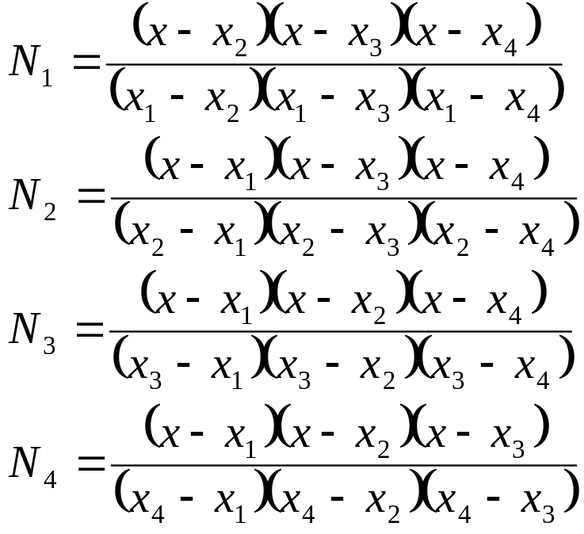
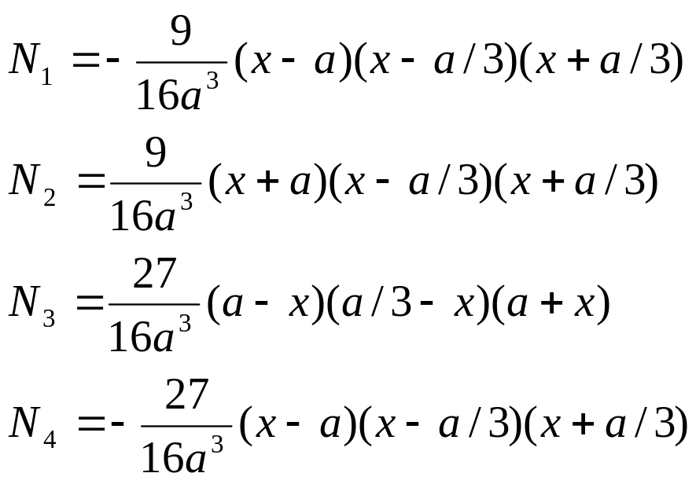
4-noded (cubic) element:
x₁
x₃
x₄
x₂
x
1
3
4
2
In “local” coordinate system (shifted to center of element)
2a/3
2a/3
2a/3
x
1
3
4
2
a
a

Slide 8


Polynomial completeness
Convergence
rate (displacement)
2 node; k=1; p=2
3 node; k=2; p=3
4 node; k=3; p=4
Recall that the convergence in displacements
k=order of complete polynomial

Slide 9
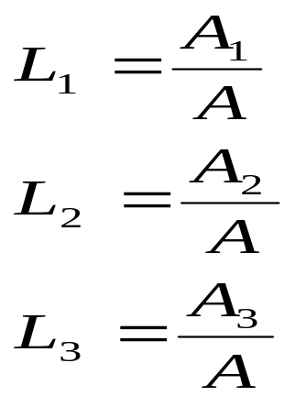
Triangular elements
Area coordinates (L₁, L₂, L₃)
1
Total area of the triangle
A=A₁+A₂+A₃
y
P
A₂
At any point P(x,y) inside the triangle, we define
A₃
A₁
3
2
x
Note: Only 2 of the three area coordinates are independent, since
L₁+L₂+L₃=1

Slide 10
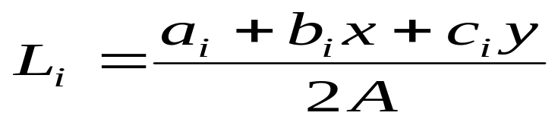
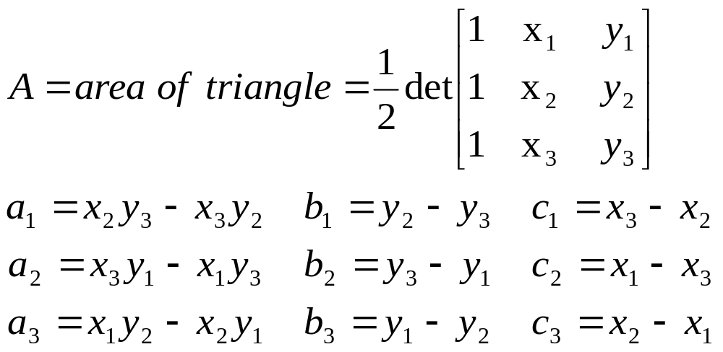

Slide 11
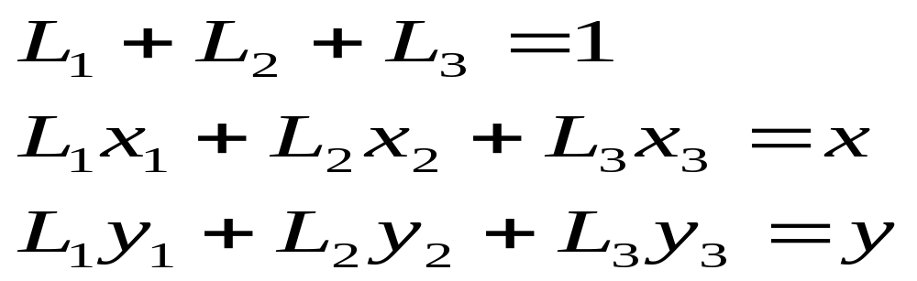
Check that

Slide 12
1
L₁= constant
P’
y
P
A₁
3
2
x
Lines parallel to the base of the triangle are lines of constant ‘L’

Slide 13
L₁= 1
1
y
P
L₁= 0
A₁
3
2
L₂= 0
L₃= 1
x
L₂= 1
L₃= 0
We will develop the shape functions of triangular elements in terms of the area coordinates

Slide 14
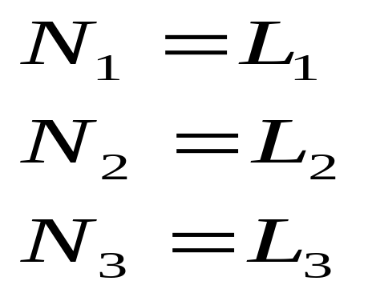
For a 3-noded triangle

Slide 15
For a 6-noded triangle
L₂= 0
L₁= 1
1
L₂= 1/2
L₁= 1/2
6
4
y
L₁= 0
L₂= 1
3
5
2
x
L₃= 0
L₃= 1/2
L₃= 1

Slide 16

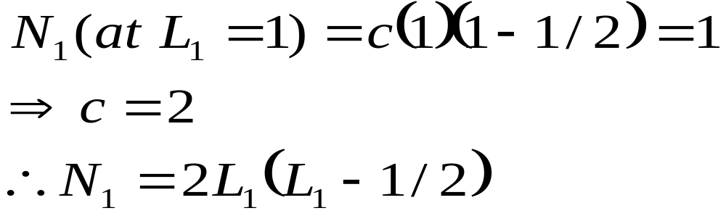
How to write down the expression for N₁?
Realize the N₁ must be zero along edge 2-3 (i.e., L₁=0) and at nodes 4&6 (which lie on L₁=1/2)
Determine the constant ‘c’ from the condition that N₁=1 at node 1 (i.e., L₁=1)

Slide 17
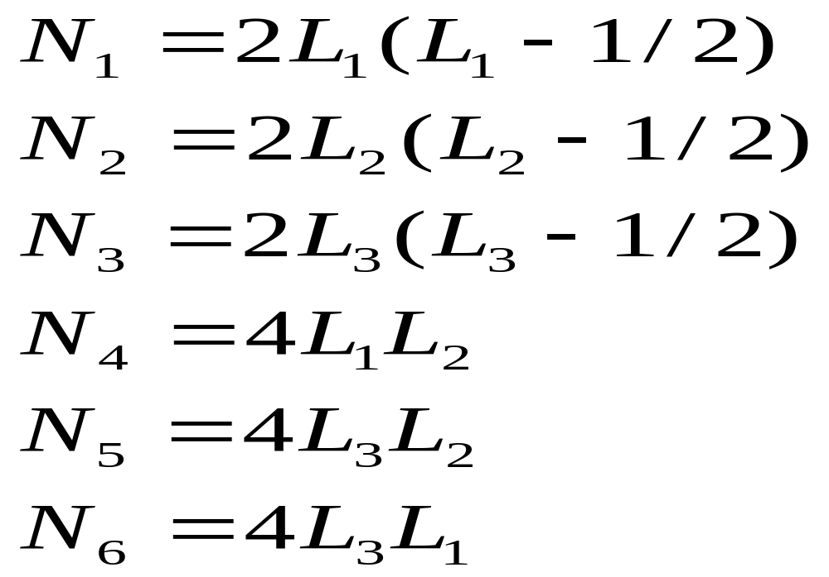

Slide 18
For a 10-noded triangle
L₂= 0
L₁= 1
L₂= 1/3
1
L₁= 2/3
9
L₂= 2/3
4
L₁= 1/3
8
y
10
L₁= 0
L₂= 1
5
3
7
2
6
x
L₃= 0
L₃= 1/3
L₃= 2/3
L₃= 1

Slide 19
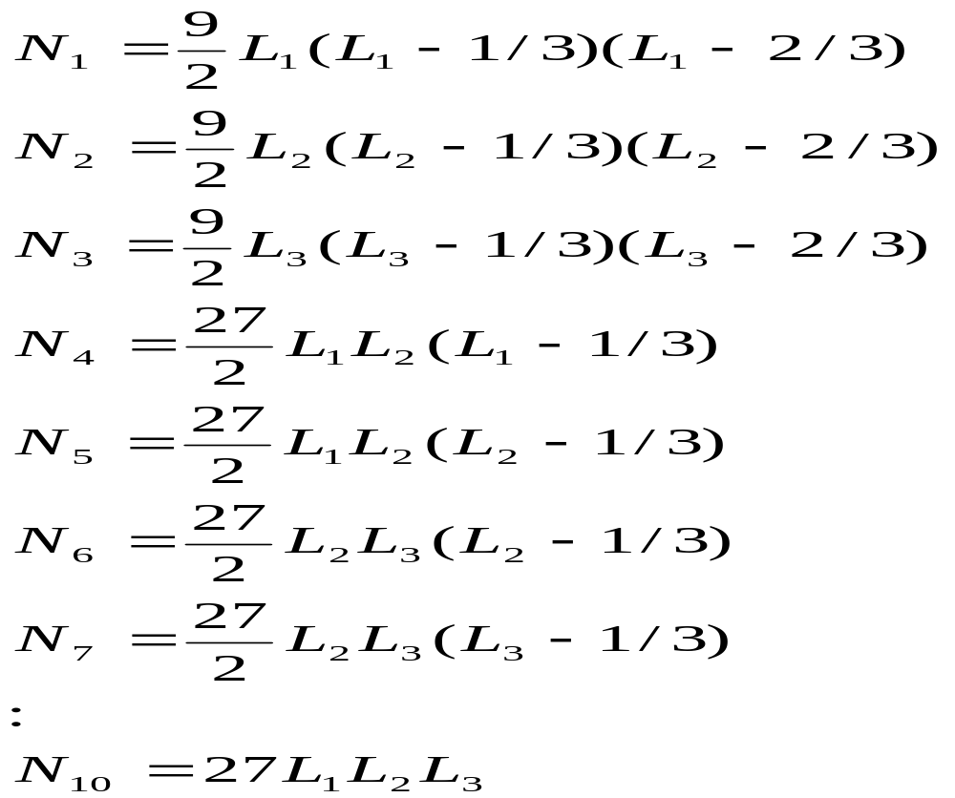

Slide 20
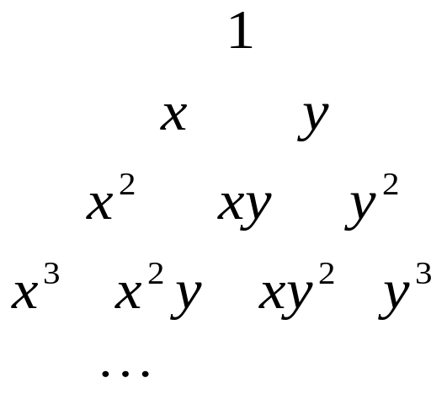
NOTES:
1. Polynomial completeness
Convergence
rate (displacement)
3 node; k=1; p=2
6 node; k=2; p=3
10 node; k=3; p=4

Slide 21
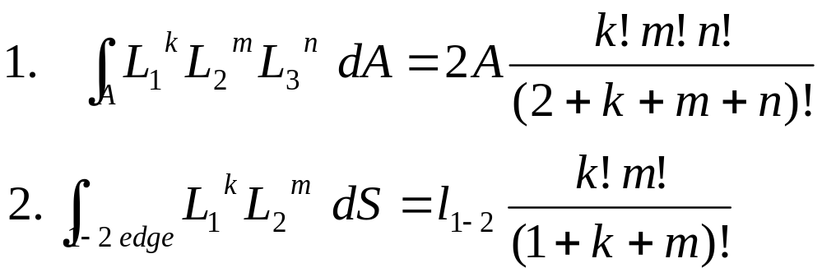
2. Integration on triangular domain
1
l₁₋₂
y
3
2
x

Slide 22
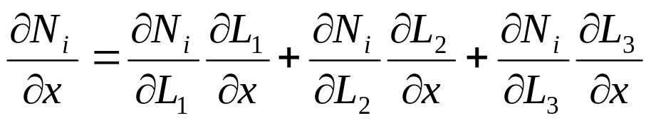
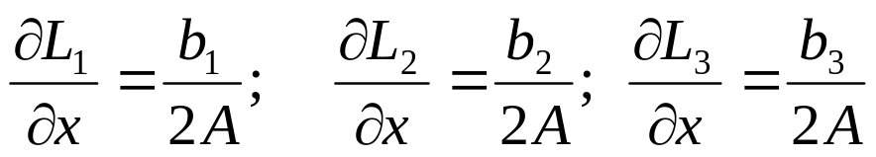
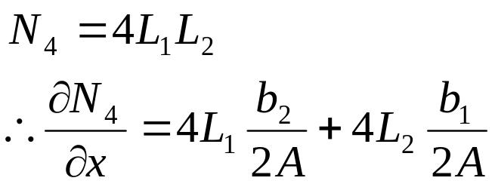
3. Computation of derivatives of shape functions: use chain rule
e.g.,
But
e.g., for the 6-noded triangle

Slide 23
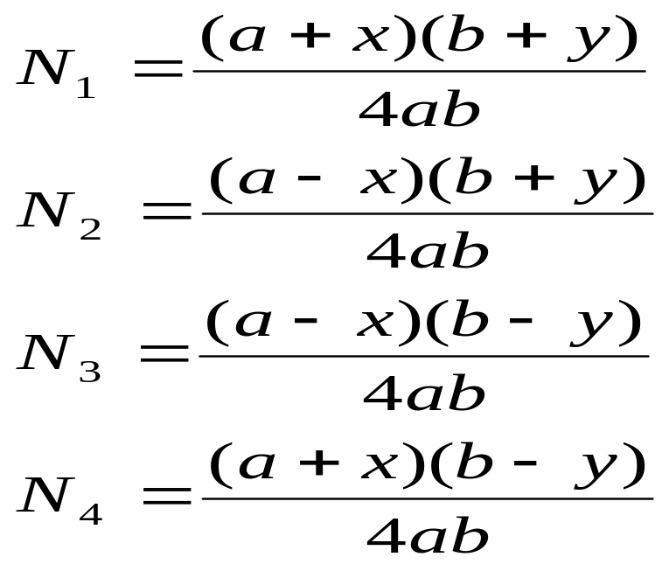
Rectangular elements
Lagrange family
Serendipity family
Lagrange family
4-noded rectangle
In local coordinate system
y
2
a
1
a
b
x
b
3
4

Slide 24
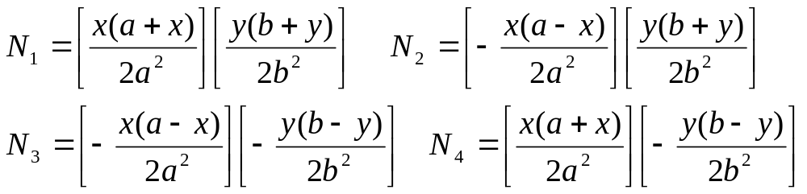
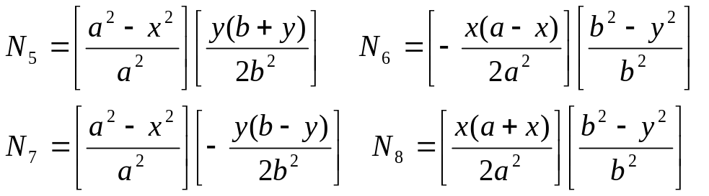
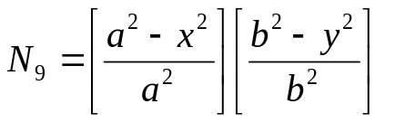
9-noded quadratic
Corner nodes
y
5
2
a
1
a
b
9
8
6
x
b
Midside nodes
7
3
4
Center node

Slide 25
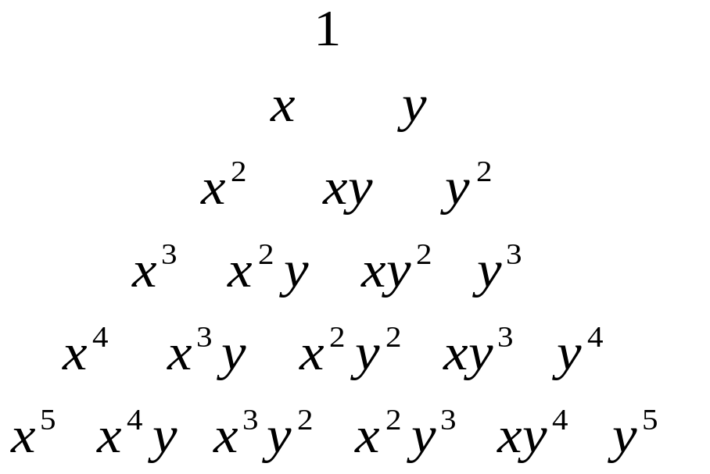
NOTES:
1. Polynomial completeness
Convergence
rate (displacement)
4 node; p=2
9 node; p=3
Lagrange shape functions contain higher order terms but miss out lower order terms

Slide 26
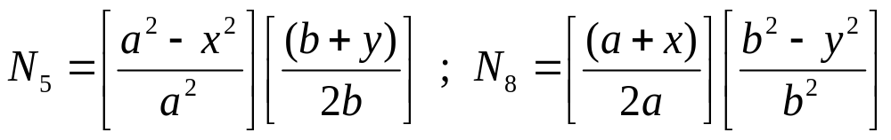
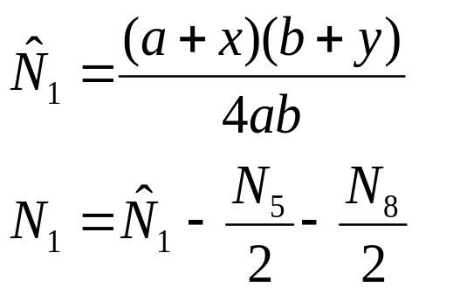
Serendipity family
4-noded same as Lagrange
8-noded rectangle: how to generate the shape functions?
First generate the shape functions of the midside nodes as appropriate products of 1D shape functions, e.g.,
y
5
2
a
1
a
b
8
6
x
b
7
3
4
Then go to the corner nodes. At each corner node, first assume a bilinear shape function as in a 4-noded element and then modify:
“bilinear” shape fn at node 1:
actual shape fn at node 1:

Slide 27
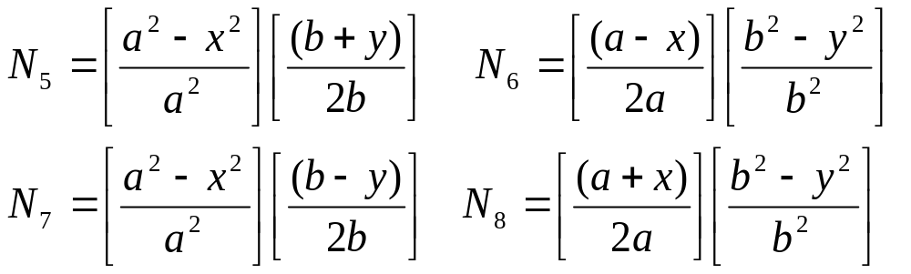
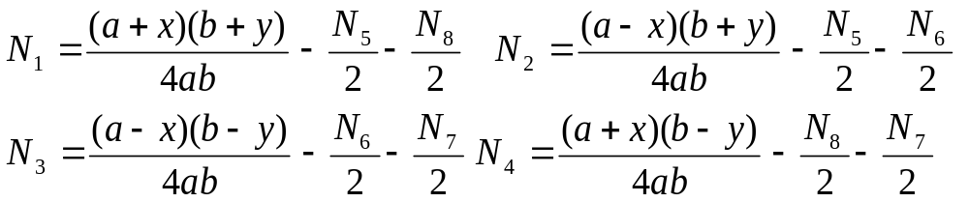
8-noded rectangle
Midside nodes
y
5
2
a
1
a
b
8
6
x
b
7
3
4
Corner nodes

Slide 28
NOTES:
1. Polynomial completeness
Convergence
rate (displacement)
4 node; p=2
8 node; p=3
12 node; p=4
16 node; p=4
More even distribution of polynomial terms than Lagrange shape functions but ‘p’ cannot exceed 4!

